Slide 1
COMPUTER FUNDAMENTALS
.
Evaluate the translation processes of interpreters and compilers.

Slide 2



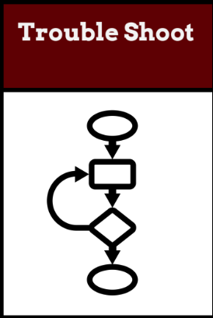
Do Now Activity (5 mins)
TOK
To what extent can data manipulation be considered an objective process when human judgment influences how databases are designed and interpreted?
L1 : Can you think of an analogy for how the OS abstracts hardware complexities? (Hint: Think of a translator or a waiter in a restaurant.)
L2:Explain what is Operating system with real life examples ?
L3: Mention what is a Control system with the support of an example.
Learning Intention: Evaluate the translation processes of interpreters and compilers.
Success Criteria:
Students will be able to analyse the flow of instructions through a pipeline and identify potential hazards.
Students will be able to evaluate the impact of pipelining on instruction throughput and execution time.
Students will be able to explain the advantages of multi-core processors for multitasking and parallel processing.

Slide 3
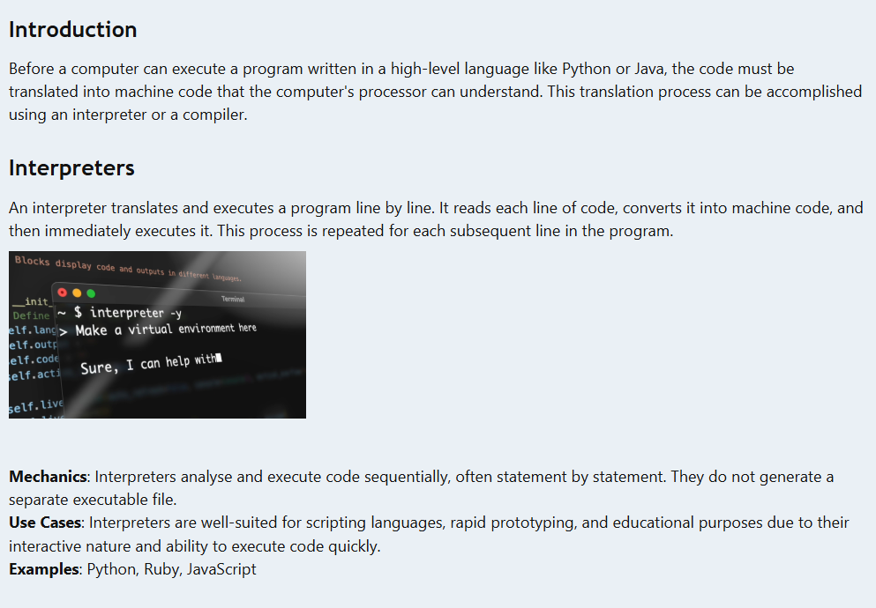

Slide 4
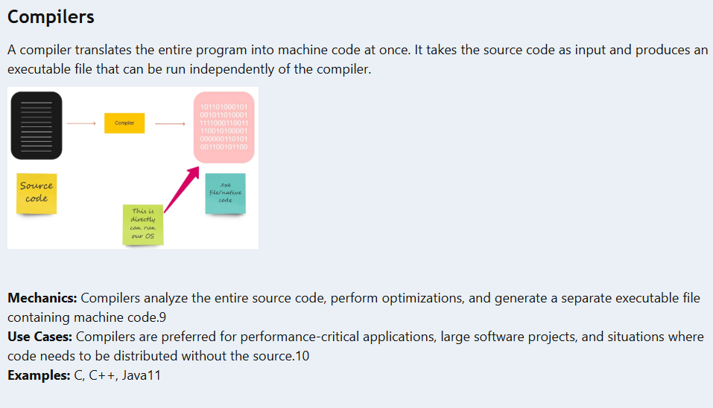

Slide 5
Challenging Activities - 20 mins
What are the main advantages and disadvantages of using an interpreter versus a compiler?
How does the execution speed of interpreted code compare to compiled code?
Why are interpreters often preferred for scripting languages?

Slide 6
TASK 2
How do error detection, translation time, portability, and applicability differ for various translation processes, including just-in-time (JIT) compilation and bytecode interpreters?

Slide 7
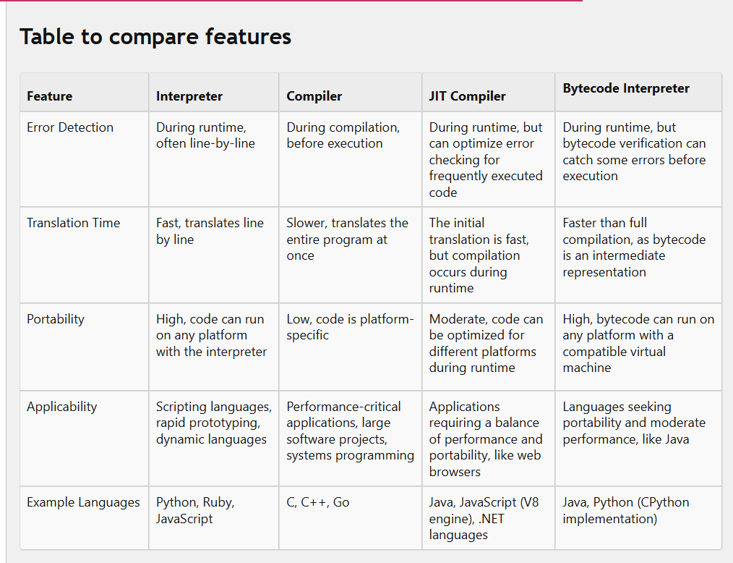

Slide 8
Interpreters excel in rapid development and portability but may lag in performance for larger applications.
Compilers prioritize performance and optimization but often sacrifice portability.
JIT compilers offer a balance between performance and portability by dynamically compiling code during runtime.
Bytecode interpreters provide a good compromise between portability and performance, leveraging an intermediate representation for execution.

Slide 9
Plenary
Which of the following is NOT a core function of an operating system?
A. Running application software
B. Compiling source code
C. Providing a user interface
D. Managing system resources
What is the purpose of abstraction in an operating system?
A. To make the computer run faster
B. To prevent software crashes
C. To enable multitasking
D. To hide complex hardware details from users and applications
Which scheduling algorithm gives each process a fixed time slice on the CPU?
A. Round Robin
B. First-Come, First-Served
C. Multilevel Queue Scheduling
D. Priority Scheduling

Slide 10
Home Learning - 20 mins
How does JIT compilation improve the performance of interpreted languages?
What are the advantages of using bytecode interpreters?
How do error detection mechanisms differ between interpreters and compilers?

